Slide 1
Introduction to Machine Learning -- Bootcamp 2015
Bo Zong
09/16/2015

Slide 2


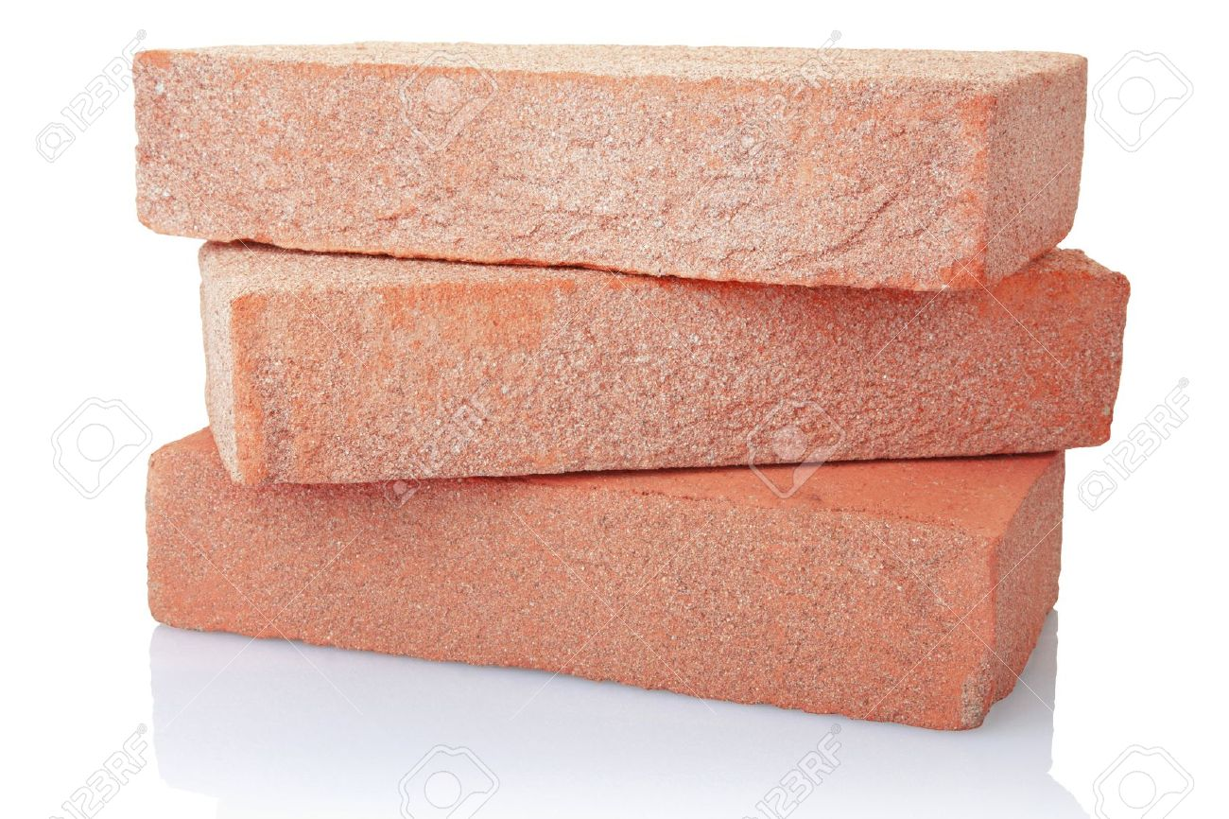
AI Dream
AI Paradise
Why we intelligent?
Machines are smart like us
Play video games all day!
Machine learning

Slide 3
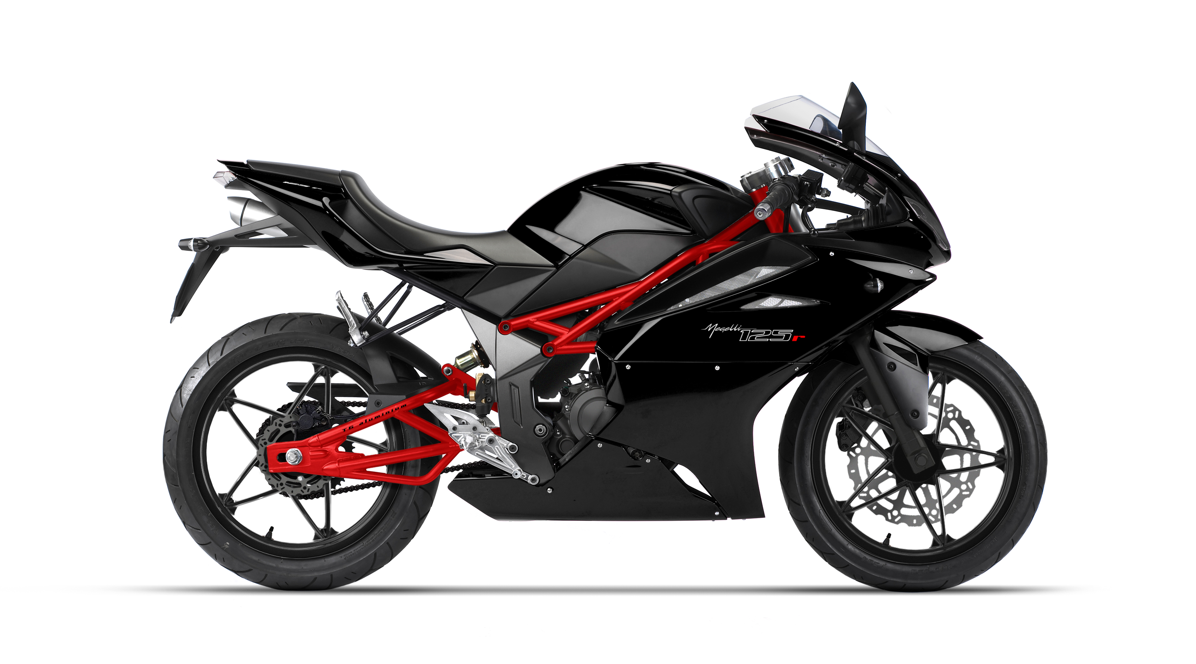
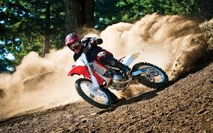
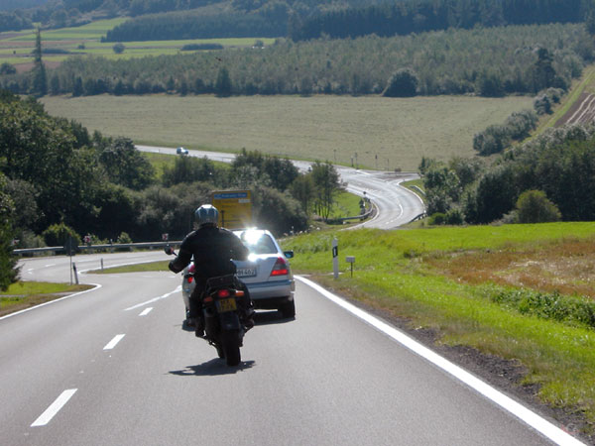
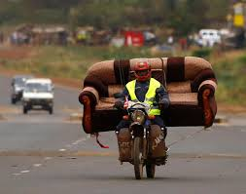
It’s Hard to Manually Teach Machines
Computer vision is hard
Only have two wheels
Mostly back
Some red
Sometimes with human
It’s infeasible to teach machine by a set of hand-crafted rules

Slide 4
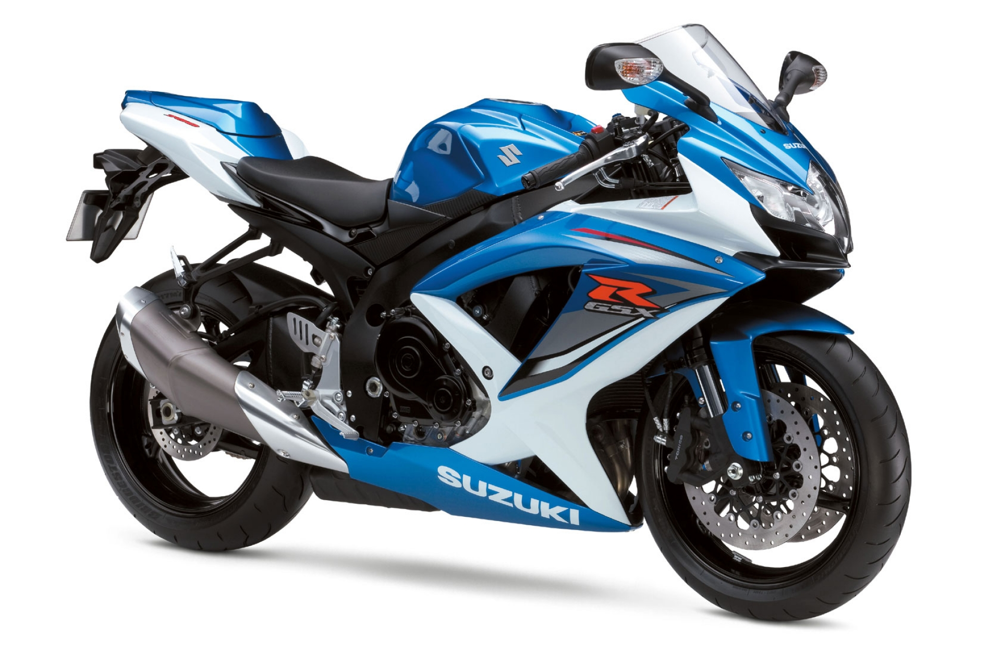

Machines Learn “Rules” By Themselves
Training machine to see
Motorcycle!
HOW?
Millions of imges

Slide 5
Roadmap
Supervised learning
Decision Tree and Random Forest
Liner Regression and Support Vector Machine
Logistic Regression and Neural Network
Unsupervised learning
k-Means, k-Medoids, and Hierarchical Clustering
Mixture Modeling

Slide 6
Supervised learning
Bo Zong
09/16/2015

Slide 7
Are you going to buy a Mac Pro?
Age | Income | Student | Credit rating | Buy Mac Pro
<= 30 | High | No | Fair | No
<= 30 | High | No | Excellent | No
31 … 40 | High | No | Fair | Yes
> 40 | Medium | No | Fair | Yes
> 40 | Low | Yes | Fair | Yes
> 40 | Low | Yes | Excellent | No
31 … 40 | Low | Yes | Excellent | Yes
<= 30 | Medium | No | Fair | No
<= 30 | Low | Yes | Fair | Yes
> 40 | Medium | Yes | Fair | Yes
<= 30 | Medium | Yes | Excellent | Yes
31 … 40 | Medium | No | Excellent | Yes
31 … 40 | High | Yes | Fair | Yes
> 40 | Medium | No | Excellent | No

Slide 8
Training Data
Labels
Age | Income | Student | Credit rating | Buy Mac Pro
<= 30 | High | No | Fair | No
<= 30 | High | No | Excellent | No
31 … 40 | High | No | Fair | Yes
> 40 | Medium | No | Fair | Yes
> 40 | Low | Yes | Fair | Yes
> 40 | Low | Yes | Excellent | No
31 … 40 | Low | Yes | Excellent | Yes
<= 30 | Medium | No | Fair | No
<= 30 | Low | Yes | Fair | Yes
> 40 | Medium | Yes | Fair | Yes
<= 30 | Medium | Yes | Excellent | Yes
31 … 40 | Medium | No | Excellent | Yes
31 … 40 | High | Yes | Fair | Yes
> 40 | Medium | No | Excellent | No
Task: Given the info of a new user, tell me if she will buy a Mac Pro.

Slide 9
Supervised Learning
Machine learning tasks aim to infer functions from labeled training data^{[1]}.
Classification
Predicts categorical class labels
E.g., is this customer going to buy a mac (Yes/no)?
Prediction
Predicts continuous values
E.g., how much will this customer spend on a computer?

Slide 10
Typical Applications
Credit card approval
E.g, will this user pay credit cards on time?
Target marketing
E.g, will Bo buy an Xbox one in December?
Medical diagnosis
E.g, Do these symptoms suggest cancer?
Fraud detection
E.g., Is this transaction performed by the user’s authorization?

Slide 11
Two-Step Process (1)
Model construction
The set of samples used in this step is training data
Each sample belongs to a predefined class, suggested by its class label
The model is represented as classification rules, decision trees, or other functions
Training data
Training algorithm
Classifier
(Model)

Slide 12
Two-Step Process (2)
Model usage: classifying new objects
Estimate model accuracy
The set of samples for testing accuracy is testing data
Accuracy rate is the percentage of correctly classified samples
Testing data is independent of training data
If the accuracy is acceptable, apply it to new data
Classifier
(Model)
Testing data
New data

Slide 13
Classification/Prediction Methods
Manual Study
Rule-based methods
Cannot scale up (labor-intensive)
Automatic Learning
Decision tree
Naïve Bayes
K-nearest neighbor
Neural Network
……

Slide 14
Decision tree and random forest
Bo Zong
09/16/2015

Slide 15
Training dataset
Age | Income | Student | Credit rating | Buy Mac Pro
<= 30 | High | No | Fair | No
<= 30 | High | No | Excellent | No
31 … 40 | High | No | Fair | Yes
> 40 | Medium | No | Fair | Yes
> 40 | Low | Yes | Fair | Yes
> 40 | Low | Yes | Excellent | No
31 … 40 | Low | Yes | Excellent | Yes
<= 30 | Medium | No | Fair | No
<= 30 | Low | Yes | Fair | Yes
> 40 | Medium | Yes | Fair | Yes
<= 30 | Medium | Yes | Excellent | Yes
31 … 40 | Medium | No | Excellent | Yes
31 … 40 | High | Yes | Fair | Yes
> 40 | Medium | No | Excellent | No

Slide 16
A Decision Tree for “Buy Mac Pro”
Age?
<= 30
31 … 40
> 40
Student?
Yes
Credit rating?
No
Yes
Excellent
Fair
No
Yes
No
Yes

Slide 17
How to Build Decision Trees (1)
Basic algorithm (a greedy algorithm)
Tree is constructed in a top-down recursive divide-and-conquer manner
At start, all the training samples are at the root
Select the attribute that maximizes a predefined metric (e.g., information gain)
Samples are partitioned recursively based on the selected attributes

Slide 18
How to Build Decision Trees (2)
Conditions for stopping partitioning
All samples for a given node belong to the same class
There are no attributes left for more partitioning – majority vote
There are no samples left

Slide 19
Example for Building Decision Trees
Available attributes
Age
Income
Student
Credit rating
Training data
Age?
<= 30
31 … 40
> 40
Student?
Yes
Credit rating?
No
Yes
Excellent
Fair
No
Yes
No
Yes
Metrics for attribute selection
Information gain
Gain ratio
Gini index

Slide 20
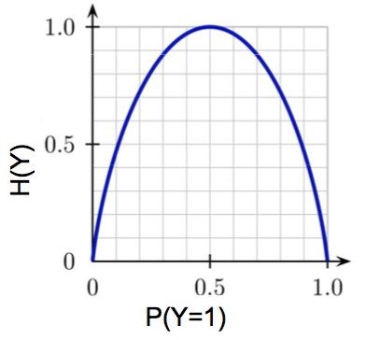
Attribute Selection: Information Gain (1)
Entropy
Y, the variable for class labels
p_{i} , be the probability that an arbitrary sample belongs to class i
The expected information (entropy) H(Y) needed to classify a sample

Slide 21
Attribute Selection: Information Gain (2)
Conditional entropy H(Y|A)
Information needed to perform classification after using attribute A to split the training data
Information gain by branching on attribute A

Slide 22
Example
Age | Income | Student | Credit rating | Buy Mac Pro
<= 30 | High | No | Fair | No
<= 30 | High | No | Excellent | No
31 … 40 | High | No | Fair | Yes
> 40 | Medium | No | Fair | Yes
> 40 | Low | Yes | Fair | Yes
> 40 | Low | Yes | Excellent | No
31 … 40 | Low | Yes | Excellent | Yes
<= 30 | Medium | No | Fair | No
<= 30 | Low | Yes | Fair | Yes
> 40 | Medium | Yes | Fair | Yes
<= 30 | Medium | Yes | Excellent | Yes
31 … 40 | Medium | No | Excellent | Yes
31 … 40 | High | Yes | Fair | Yes
> 40 | Medium | No | Excellent | No
Age?
<= 30
31 … 40
> 40
2 “Yes”, 3 “No”
4 “Yes”, 0 “No”
3 “Yes”, 2 “No”

Slide 23
Continuous-Valued Attributes
Let attribute A be a continuous-valued attribute
Determine the best split point for A
Sore the values of A by increasing order
The midpoint between each pair of adjacent values is considered as a possible split point
e.g., (a_{i}+a_{i+1})/2 is the split point between a_{i} and a_{i+1}
The split point with the minimum entropy for A is selected as the split-point for A
Split
Samples in one partition satisfy A ≤ split-point
Samples in the other partition satisfy A > split-point

Slide 24
Attribute Selection: Gain Ratio
Information gain is biased towards attributes with a large number of different values
e.g, SSN, cell phone number, etc.
Gain ratio is designed to overcome this problem by normalized gain
SplitInfo: entropy of attribute A
The attribute with the maximum gain ratio is selected as the splitting attribute

Slide 25
Comparison between Attribute Selection Metrics
In general, both perform well, but
Information gain: biased towards multivalued attributes
Gain ratio: tends to prefer unbalanced splits in which one partition is much smaller than others

Slide 26
Overfitting in Decision Trees
Overfitting: An induced tree may too good to be true
Too many branches, some may reflect anomalies due to noise or outliers in training samples
Poor accuracy for unseen samples
Two approaches to avoid overfitting
Pre-pruning: Halt tree construction early
Define a metric to quantify the complexity of a decision tree
In construction, do not split a node if this would result in a too complex tree
Problem: difficult to define such a metric and a threshold indicating too complex
Post-pruning: Remove branches when a tree is built up
Use a set of data different from the training data to decide which branches will be removed

Slide 27
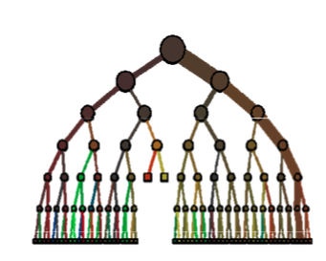
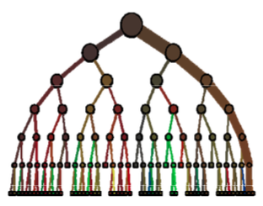
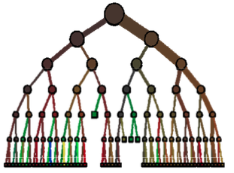
From Decision Tree to Random Forest
Decision Tree
Random Forest
How to further improve the accuracy?
How many trees?
How different?
How to fuse their outputs?

Slide 28
Random Forest
An ensemble method using many decision trees
Aiming at improving prediction accuracy
Encouraging diversity among the trees
Main ideas: Bootstrap and Ensemble

Slide 29
Bootstrap
How it works?
Given a dataset of N samples
Draw N samples with replacement to create a new dataset
Repeat K times
Get K datasets drawn from the same population
Why is it useful?
Allow one to simulate repeated statistical experiments
Statistics computed from bootstrap samples are usually unbiased ^{[1]}

Slide 30
Ensemble
Combines the results from different separate models
Models can be of similar or different types
The result from an ensemble model is usually better than the result from one of the individual models
Model 1
Combination function
Separate predictions from different models
Final combined prediction
Model 2
…
Model n

Slide 31
Random Forest Construction
Let B be the number of trees in the forest
For b = 1 to B
Draw a bootstrap dataset D_{b} of size N from the training data
Grow a tree T_{b} from D_{b} by recursively repeating the following steps
Select m variables at random for all the available variables
Pick the best variable based on the predefined attribute selection metric as tree node, and partition the training samples.

Slide 32
Random Forest Classification
Let {T₁, T₂, …, T_{B}}be the trees in a random forest
Suppose C_{b}(x) is the class prediction for x from the b-th tree in the random forest
Forest output prediction: Yes
Yes
Yes
No

Slide 33
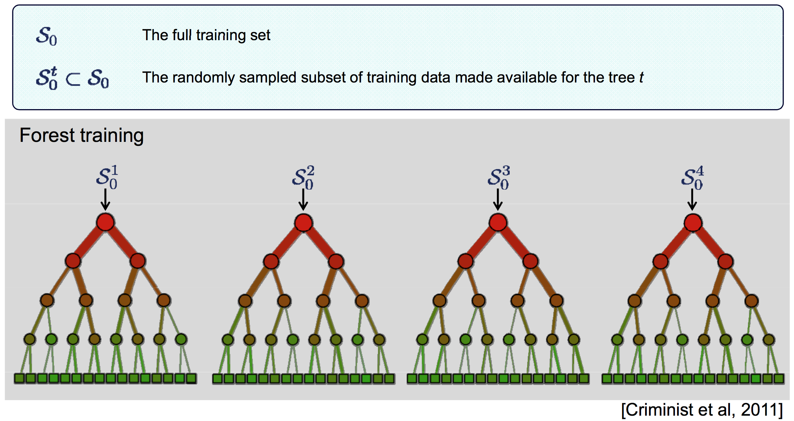
Randomness in Random Forest (1)
Bootstrapping (randomizing the training samples)

Slide 34
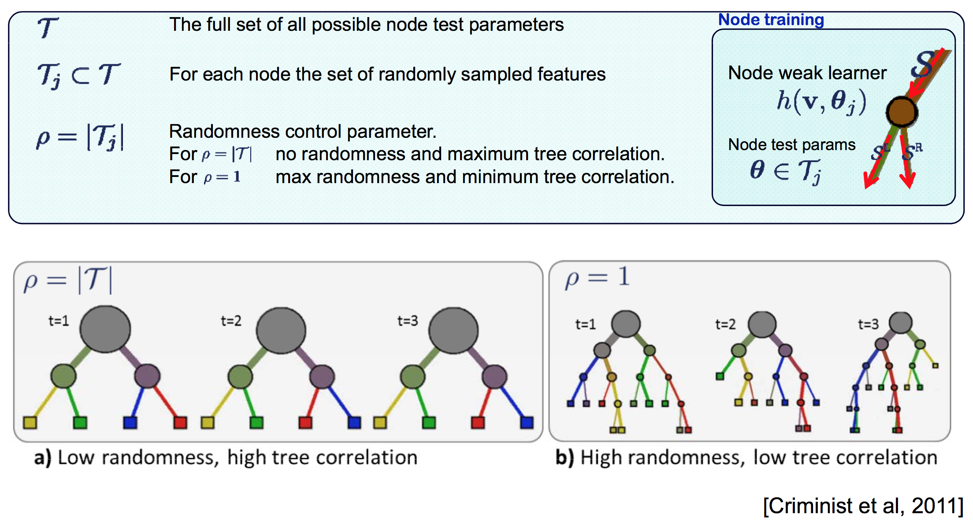
Randomness in Random Forest (2)
Randomized attribute selection

Slide 35
Advantages of Random Forest
High accuracy for most datasets
Handles a very large number of input variables
Robust to overfitting
No need for pruning trees
Sample application
Object Detection in Kinect ^{[1]}
Credit evaluation
Medical diagnosis

Slide 36
Linear Regression and support vector machine
Bo Zong
09/16/2015

Slide 37
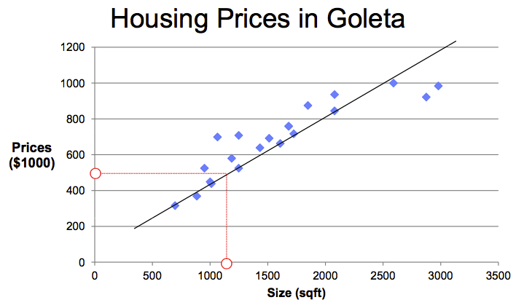
Motivating Example
Regression: Predict continuous valued output

Slide 38
Revisit Supervised Learning
How does it work?
Training Samples
Learning Algorithm
Input
Output
Hypothetic Model
Size of house
Linear function
Estimated price

Slide 39
Linear Regression as Hypothetic Model
Input variable
Hypothetic model
Parameters
x: Size of House
H(x): House price

Slide 40
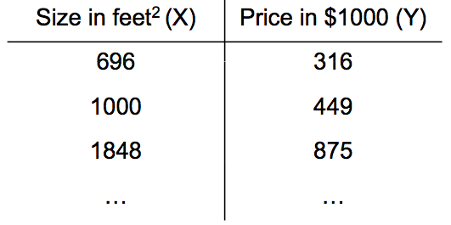
Notations
Hypothetic function
Training Samples
m: Number of training samples
X: Input variables (features, e.g., size of house)
Y: Output variables (e.g., house price)
θ: Parameters
x^{(k)}: Input variable of k^{th} training sample
y^{(k)}: Output variable of k^{th} training sample

Slide 41
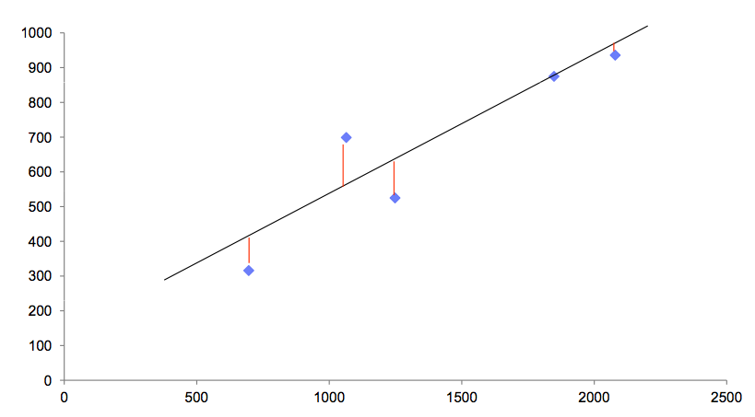
How to Choose θ
Idea: Choose θ so that H(x) is close to y for each training example (x, y)

Slide 42
Cost function: Square Loss Function
How to measure H(x) is close to y?

Slide 43
Cost Function Optimization
Cost function
Goal: find θ such that J(θ) is minimized
Method: Gradient descent

Slide 44
Gradient Descent
Suppose θ includes θ₀ and θ₁
Goal
General idea
Start with some (random) value of θ
Keep updating θ to reduce J(θ) until we end up with a minimum (hopefully)

Slide 45
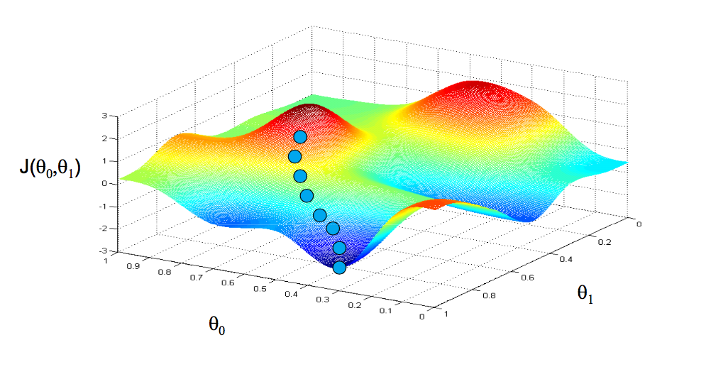
Example
Machine Learning, Coursera, Andrew Ng

Slide 46
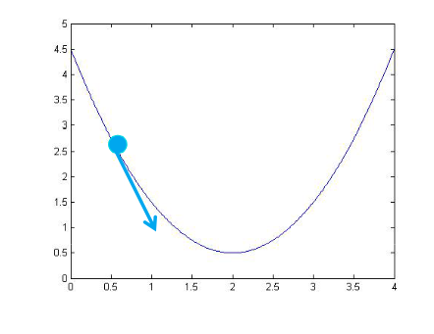
Gradient Descent: Parameter Update
J(θ)
θ_{i}
Learning ratio

Slide 47
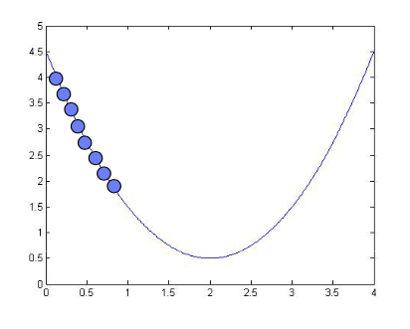
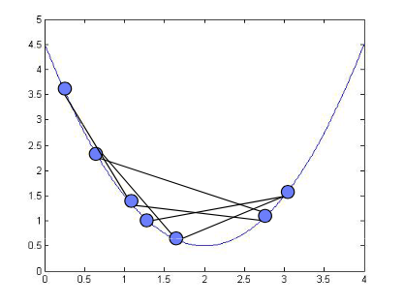
Gradient Descent: Learning Ratio α
α is too small
α is too big
J(θ)
J(θ)
θ_{i}
θ_{i}
Gradient descent may not converge
Gradient descent is slow

Slide 48
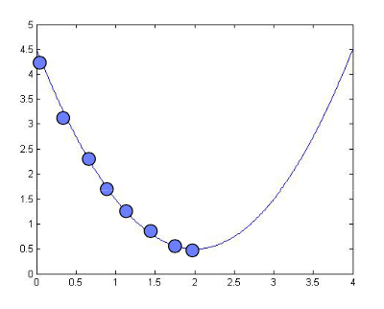
Gradient Descent: Convergence
As we approach a local minimum, gradient descent will automatically take smaller steps. So no need to decrease α over time

Slide 49
Gradient Descent Algorithm
Randomly initialize θ
Repeat until J(θ) converges
For each i

Slide 50
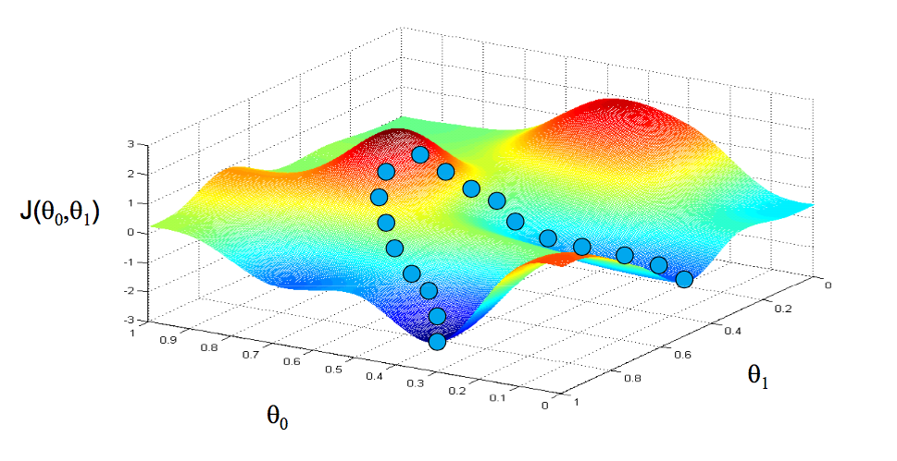
Weakness: Local Minimum
Machine Learning, Coursera, Andrew Ng

Slide 51
Gradient Descent in Linear Regression (1)
Gradient decent
Linear regression
Randomly initialize θ
Repeat until J(θ) converges
For each i

Slide 52
Gradient Descent in Linear Regression (2)
Randomly initialize θ
Repeat until J(θ) converges

Slide 53
Choice of Optimization Algorithms
In addition to gradient descent, we can use
Newton’s method
BFGS
L-BFGS
Compared with gradient descent, they usually are faster in terms of convergence
They are more complex, and harder to implement

Slide 54
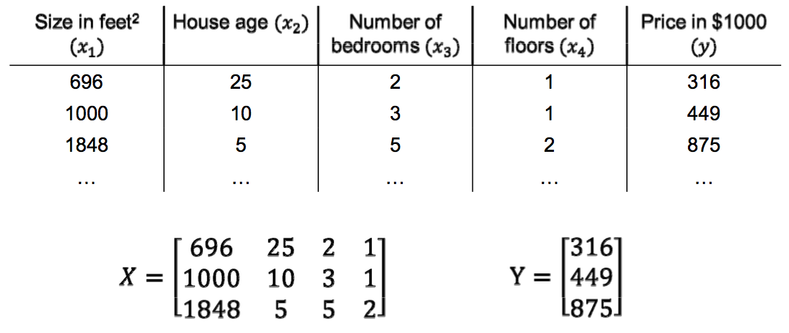
Multi-variable Linear Regression (1)
Input variable
Output variable

Slide 55
Multi-variable Linear Regression (2)
Hypothetic Function
Cost function
x_{i}^{(k)} is the i^{th} feature of the k^{th} training sample

Slide 56
Gradient Descent for Multi-variable Linear Regression
Randomly initialize θ
Repeat until J(θ) converges
For each i

Slide 57
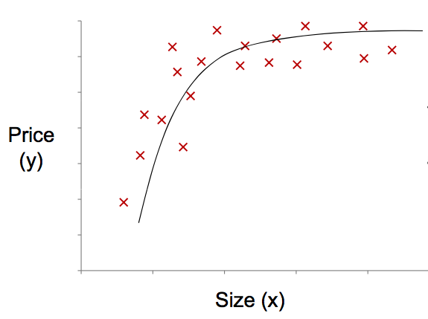
Extension: Polynomial regression
Hypothetic model
Cost function

Slide 58
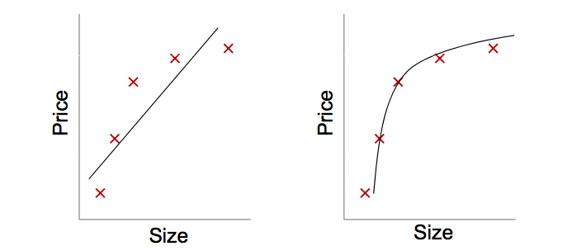
Model Selection: Underfitting
Underfitting: If we have very few features, the learned model fails to fit the training samples. Thus, it fails to generalize to new samples (e.g., predict prices on new houses).

Slide 59
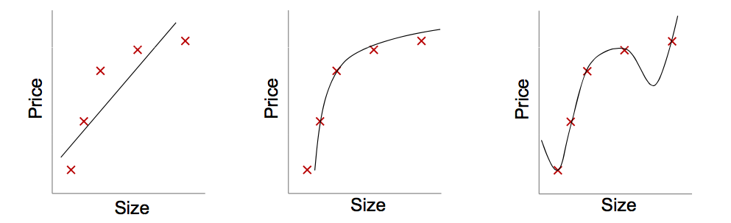
Model Selection: Overfitting
Overfitting: If we have too many features, the learned model may fit the training samples too well, but it still fails to generalize to new samples (e.g., predict prices on new houses).

Slide 60
How to Address Overfitting
Reduce number of features
Manually select features by domain knowledge
Feature selection algorithm, such as PCA
Regularization
Keep all the features, but reduce magnitude/values of parameters
Identify the features that are necessary

Slide 61
Linear Regression with Regularization
Cost function
Gradient descent
Regularization term
Randomly initialize θ
Repeat until J(θ) converges
For each i

Slide 62
Linear Regression: Another Angle
Learn:
By taking derivative w.r.t. θ, setting to zero,
Note: θ lies in the space spanned by training samples

Slide 63
Linear Regression: Dual form
Using the Fact
Solution
Weight vector is represented as a linear combination of the training samples
Note: Only inner products between input samples are involved, we can play kernel trick

Slide 64
Kernel Trick
Since the computation only involves inner products, we can substitute fro all occurrences of by a kernel function
Then we obtain a regression model in the feature space F defined by the mapping
Example: Quadratic kernel

Slide 65
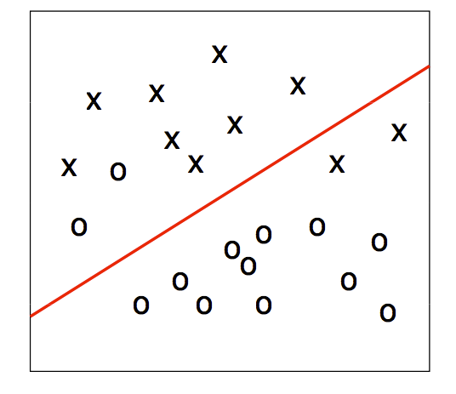
Not Linearly Separable
Introduce errors
Introduce new features
Introduce non-linear model

Slide 66
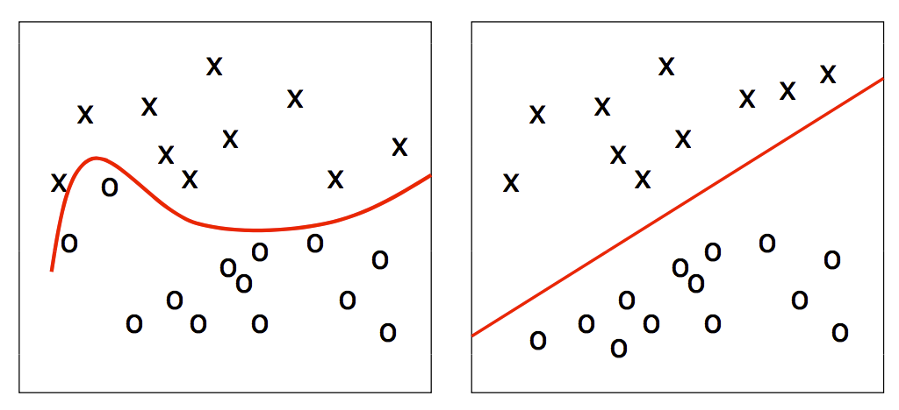
Feature Space

Slide 67
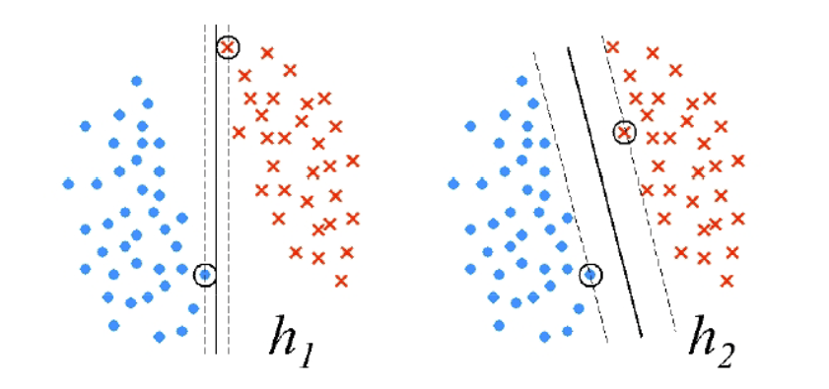
Support Vector Machine
Which one is better?
Statistical learning theory shows h₂ is better!

Slide 68
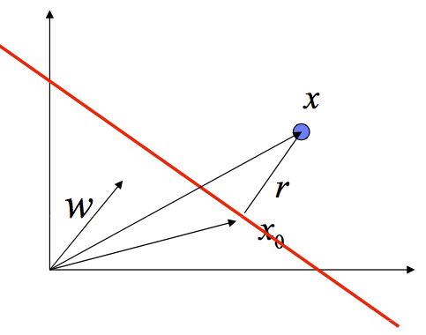
Margin
Margin: distance between the closest sample and the decision hyperplane

Slide 69
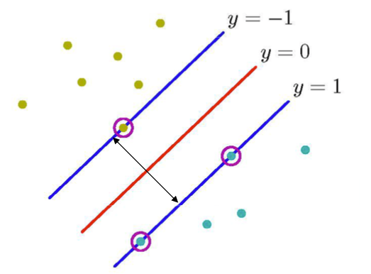
Maximum Margin
If we fix the closes x as f(x) = 1 or -1, then the margin is
Minimize θ

Slide 70
Optimization Problem
Minimize
Subject to
Introduce Lagrange Multipliers
Note: θ lies in the space spanned by training samples

Slide 71
Dual Form for SVM
Note: λ_{k} is equal to 0 for the samples that are not on the plane f(x) = 1 or -1

Slide 72
Why is SVM Effective on High Dimensional Data?
The complexity of trained classifier is characterized by # of support vectors rather than the dimensionality of the data
The support vectors are the essential or critical training examples – they lie closest to the decision boundary
If all other training samples are removed and the training is repeated, the same separating hyperplane would be found
An SVM with a small number of support vectors can have generalization, even when the dimensionality of the data is high

Slide 73
Logistic regression and neural network
Bo Zong
09/16/2015

Slide 74
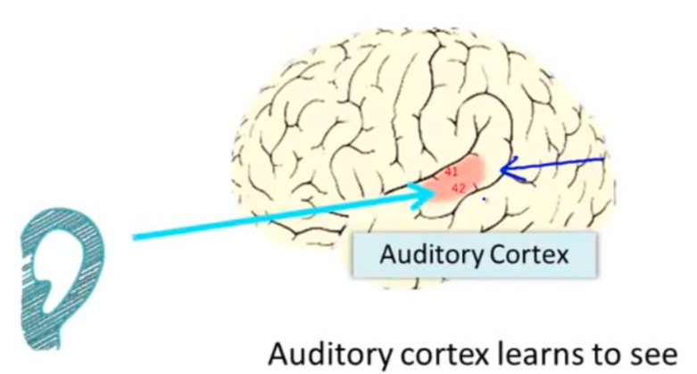
“One Learning Algorithm” Hypothesis (1)
Newton et al. “Rewiring Cortex: Functional Plasticity of the Auditory Cortex during Development”. Plasticity and Signal Representation in the Auditory System’05

Slide 75
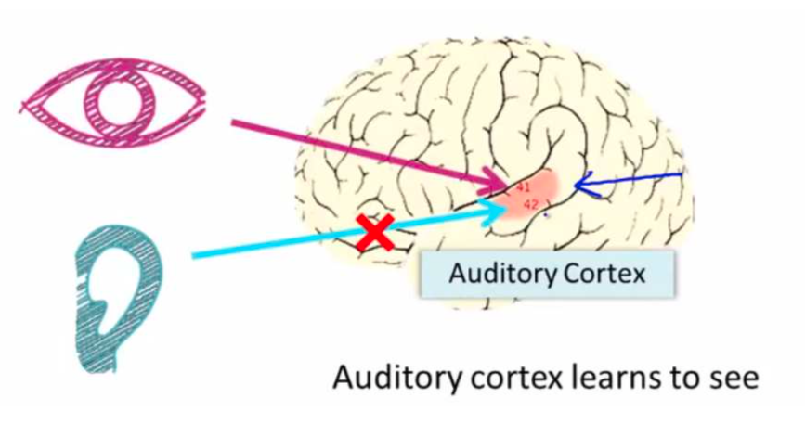
“One Learning Algorithm” Hypothesis (2)
Newton et al. “Rewiring Cortex: Functional Plasticity of the Auditory Cortex during Development”. Plasticity and Signal Representation in the Auditory System’05

Slide 76
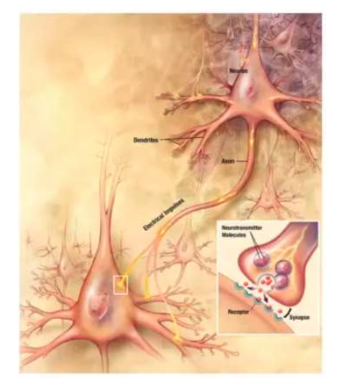
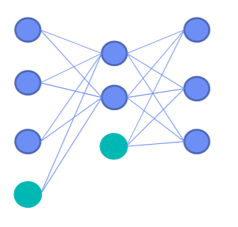
What is Neural Network?
Input
Hidden
Output

Slide 77
Perceptron: the Simplest Neural Network
x₁
w₁
x₂
w₂
x: n-dimensional input
w: parameters (weights)
b: bias
h(x)
…
w_{n}
x_{n}
b
+1
f (.) is called Activation function, e.g., Sigmoid function
Logistic regression

Slide 78
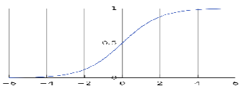
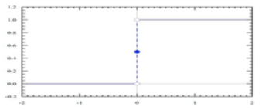
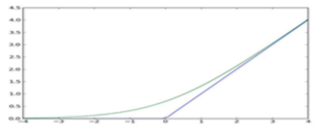
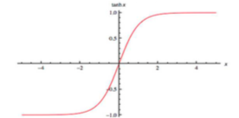
Activation Functions
Sigmoid function
Step function
Rectifier function
Hyperbolic tan function

Slide 79
Learn Algorithm for Perceptron
Initialize w, b
For each data point (x, y), make prediction
If y ≠ h(x), update the parameters by gradient descent
Else w and b does not change
Repeat until convergence

Slide 80
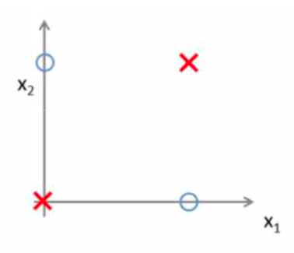
Non-Linear Classification
x₁ and x₂ are binary variables (0 or 1)
Learn y = x₁ XOR x2
Perceptron does not work as the problem is not linear separable
Solution: Multi-layer networks

Slide 81
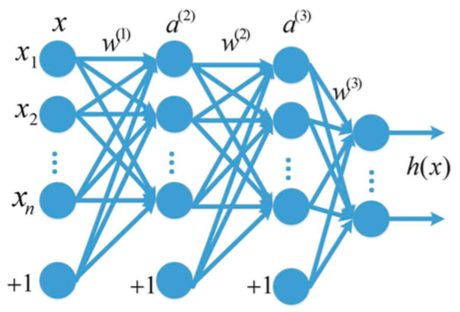
Multi-Layer Networks (1)
Feed-forward neural networks
Layer 1
Layer 2
Layer 3
Layer 4
Stack of “Perceptrons”

Slide 82
Multi-Layer Networks (2)
Input and output of 2nd layer
Input and output of 3rd layer
Output layer
Layer 1
Layer 2
Layer 3
Layer 4

Slide 83
Multi-Layer Networks (3)
Activation function f : continuous nonlinear function
(Sigmoid)
or
(tanh)
Layer 1
Layer 2
Layer 3
Layer 4
Parameters w⁽¹⁾, w⁽²⁾, w⁽³⁾, b⁽¹⁾, b⁽²⁾, b⁽³⁾ to be learned

Slide 84
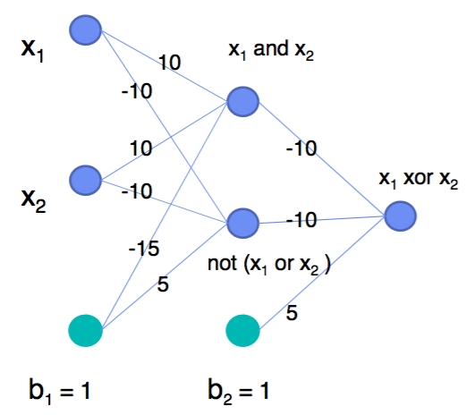
2-Layer Network for XOR function

Slide 85
Universal Approximation Theorem
Here “mild” means any non-constant, bounded, and monotonically-increasing continuous function
Example activation functions
Sigmoid function
Hyperbolic Tan function
Rectifier function
A feed-forward network with a single hidden layer containing a finite number of neurons can approximate continuous functions on compact subset of R^{n}, under mild assumptions on the activation function.

Slide 86
Parameter Estimation
Given training samples:
Minimize cost function
where
: Average sum-of-square error term
: Regularization term (L, # layers)

Slide 87
Optimization Algorithm
Gradient descent
Backpropagation: a systematic way to compute
and

Slide 88
Backpropagation (1)
Perform a feedforward pass, compute the activations for all layers, and obtain h(x)
Input and output of 2nd layer
Input and output of 3rd layer
Output layer
Layer 1
Layer 2
Layer 3
Layer 4

Slide 89
Backpropagation (2)
Apply Chain Rule to compute gradients backward

Slide 90
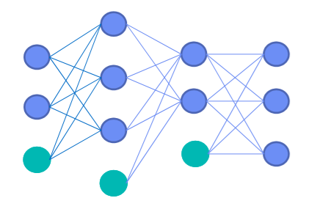
Problems in Backpropagation
Slow in networks with multiple hidden layers
Stuck in poor local optima
Overfitting
Input
Hidden
Output

Slide 91
Existing Solutions
For local optima
Use better initialization (e.g., Restricted Boltzmann Machine)
Find better structures
For overfitting
Training with more data
Regularization terms
Reduce the number parameters (e.g., Convolutional Neural Network)

Slide 92
Unsupervised learning
Bo Zong
09/16/2015

Slide 93
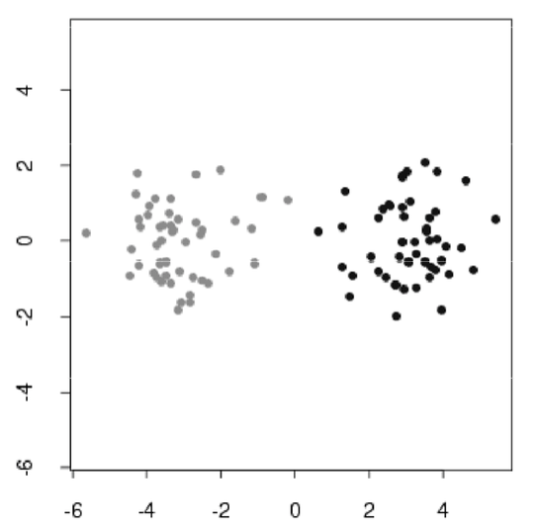
Unsupervised Learning
Supervised: training data are labeled
Unsupervised: training data are not labeled
No measure of success
Heuristic arguments for evaluation

Slide 94
Methods Discussed in This Lecture
Basic clustering algorithms
k-Means
k-Medoids
Hierarchical clustering
Mixture modeling

Slide 95
Basic Clustering algorithms
Bo Zong
09/16/2015

Slide 96
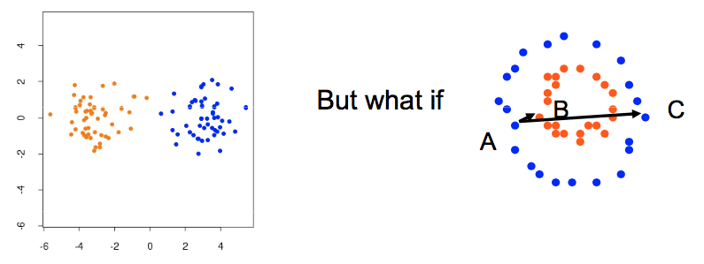
Cluster Analysis
Grouping a collection of objects into clusters, such that those within cluster are more closely related
Core problem: distance definition
Intra cluster distance
Inter cluster distance

Slide 97
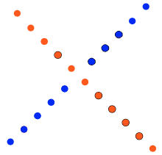
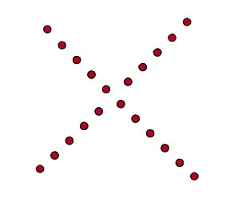
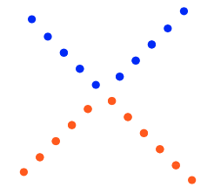
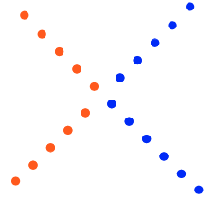
Tricky Situations
No perfect method

Slide 98
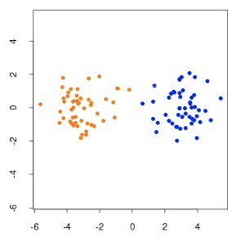
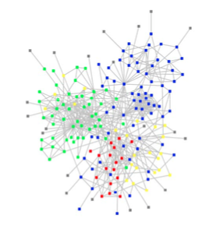
Distance Measures (1)
Metric function, which satisfies:
Non-negative:
Triangle inequality:
Symmetric:
Non-metric function
No Triangle inequality
No Symmetry
e.g., weighted shortest path in graph

Slide 99

Distance Measures (2)
Euclidean distance
Mixture modeling
Infinity Distance

Slide 100
Intra-Cluster Distance
Minimize intra-cluster, equivalent to maximize inter-cluster distance
Intra-cluster distance
Total distance, which is fixed
Inter-cluster distance:

Slide 101
k-Means
Distance measure: Squared Euclidean Distance
Minimize the sum of squared error distance
where

Slide 102
k-Means Iterative Optimization
Initialize: Partition the data into k initial clusters
Step 1: Compute the mean of each cluster
Step 2: Assign each data point to the closest partition
Step 3: If any data point changed its cluster membership, then repeat from Step 1

Slide 103

Example: k-Means

Slide 104
Comments on k-Means
Strength: Relatively efficient: O(tkn)
n is # objects
k is # clusters
t is # iterations. Normally, k, t << n
Fact
Results depend on the initialization of the clusters
Its result may be a local optimum, not the global optimal
Weakness
Applicable only when mean is defined (what about categorical data?)
Need to specify k, the number of clusters, in advance

Slide 105

k-Medoids
Medoids are representative objects of a cluster, whose average distance to all the objects in the cluster is minimal.

Slide 106

Hierarchical Clustering (1)
Agglomerative
Start with clusters with one data point
Repeat the following process until there is only one cluster
Find a pair of clusters that are “closest” to each other compared with other pairs
Merge this pair into one cluster

Slide 107

Hierarchical Clustering (2)
Divisive
Start with one cluster including all data points
Repeat the following process until no cluster can be divided
Pick a cluster that can be divided, and find the way to divide the cluster so that two sub-clusters are “closest” to each other among all possible divisions
Divide the cluster into two smaller clusters

Slide 108

Hierarchical Clustering (3)
Both agglomerative and divisive methods can generate results as dendrogram

Slide 109
Calculate the Distance between Clusters
Single link:
Smallest distance between a data point in one cluster and a data point in the other
Complete link:
Largest distance between a data point in one cluster and a data point in the other
Average:
Average distance between a data point in one cluster and a data point in the other
Centroid:
Distance between the means of two clusters
Medoid:
Distance between the medoids of two clusters

Slide 110

Basic Clustering Methods
k-Means
k-Medoids
Hierarchical Clustering
How to find clusters here?

Slide 111
Mixture modeling
09/16/2015

Slide 112

Probabilistic Models for Analyzing Clustering Data
“Hard assignment” => “Soft assignment”
Cluster membership: e.g., (0.8, 0.2)

Slide 113

Combination of Multiple Probabilistic Distributions
Two-mixture model
π_{i}, probability x is drawn from model i
p_{i}(x), given x is drawn from model i, probability that x is generated
π₀+π₁=1

Slide 114
Generative Process
All the data points are generated by the following distribution
Let x_{i} be the i^{th} data point
y_{i} is the cluster label where x_{i} is generated
P(y_{i}=c_{k}) is the probability that k^{th} cluster generates a data point
P(x|y_{i}=c_{k}) can be any distribution, e.g., Gaussian distribution

Slide 115

Example: Mixture of Two Gaussians
K = 2

Slide 116
Parameter Estimation (1)
Estimate P(y_{i} = c_{k})
Estimate parameters in P(x_{i}|y_{i} = c_{k})
e.g., μ_{k}, σ_{k} in Gaussian distribution (for k^{th} cluster)
Maximum Likelihood Estimation (MLE)
θ are the set of parameters to be estimated

Slide 117
Parameter Estimation (2)
Suppose we have a mixture of Gaussians
If there are cluster labels for data
But cluster labels are usually unknown
Easy!

Slide 118
Parameter Estimation with Latent Labels
For mixture of Gaussians
Computing derivatives over μ_{k}, σ_{k}, and P(y_{i} = c_{k}) and setting them to zero
No closed forms!

Slide 119
EM Algorithm
An iterative scheme: alternating between E-step (expectation step) and M-step (maximization step)
E-step: compute z_{ik} based on current parameters
M-step: update the parameters μ_{k}, σ_{k}, and P(y_{i} = c_{k}) based on z_{ik}
Until convergence

Slide 120
General EM Algorithm: Pictorial View
Objective
Given parameters and training data
Maximize the expected joint likelihood over the parameters
Estimate the cluster label of each data point

Slide 121

Gaussian Mixture Example (1)
After the 1st iteration

Slide 122

Gaussian Mixture Example (2)
After the 2nd iteration

Slide 123

Gaussian Mixture Example (3)
After the 3rd iteration

Slide 124

Gaussian Mixture Example (4)
After the 4th iteration

Slide 125

Gaussian Mixture Example (5)
After the 5th iteration

Slide 126

Gaussian Mixture Example (6)
After the 6th iteration

Slide 127

Gaussian Mixture Example (7)
After the 20th iteration

Slide 128
Thank you!
Questions?
Survey:

